Slide 1
Analyzing Business Success Impact Factors with Yelp & Crime data
Xiancheng Yin , Khawlah Basulayb

Slide 2
Business Questions:
1. How does the time of day, day of week and cuisine type, impact customer check-ins ?
2. Which cuisine types have the highest check-ins during different times of the day?
3. What is the impact of crime on business if there is(Philadelphia Crime Data) ?
4. What is the relationship between number of reviews, reaction to review and number of tips?
5. How public safety concerns in the area of Philadelphia affect business types and customer behaviors( check-in time and reviews)

Slide 3
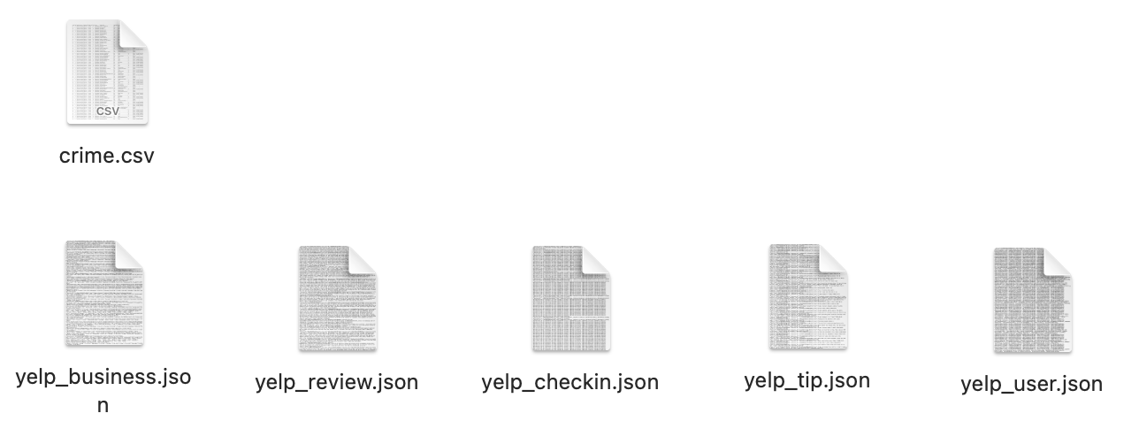
Data Source (Extract Data)
https://www.kaggle.com/datasets/yelp-dataset/yelp-dataset?select=yelp_academic_dataset_business.json
https://www.kaggle.com/datasets/mchirico/philadelphiacrimedata

Slide 4
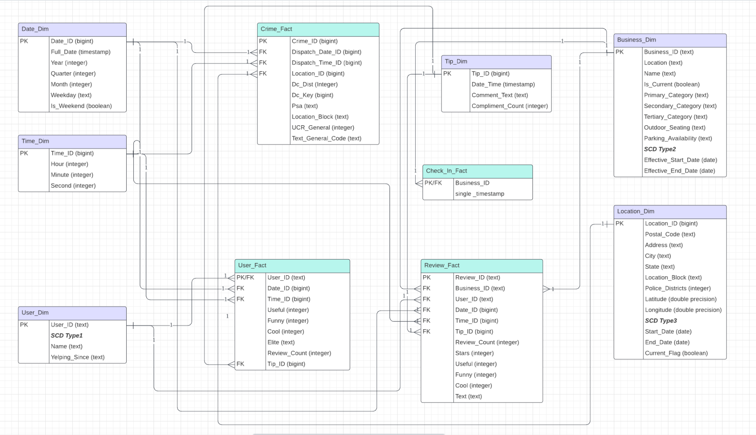
Warehouse Design

Slide 5
Warehouse Design
Snapshot Fact Tables: Crime_Fact, Review_Fact,
Cumulative Fact Table: Check_In_Fact,
Hierarchy: Year, Quarter, Month, Day…
SCD1: User_Dim
SCD2: Business_Dim
SCD3: Location_Dim
4 Fact Tables, 5 Dimention Tables except for Time_Dim

Slide 6
Data Flow
kaggle.com
yelp_data
(.json)
crime_data (.csv)
python
python
SQL Query
pgAdmin PostgreSQL
Tableau

Slide 7
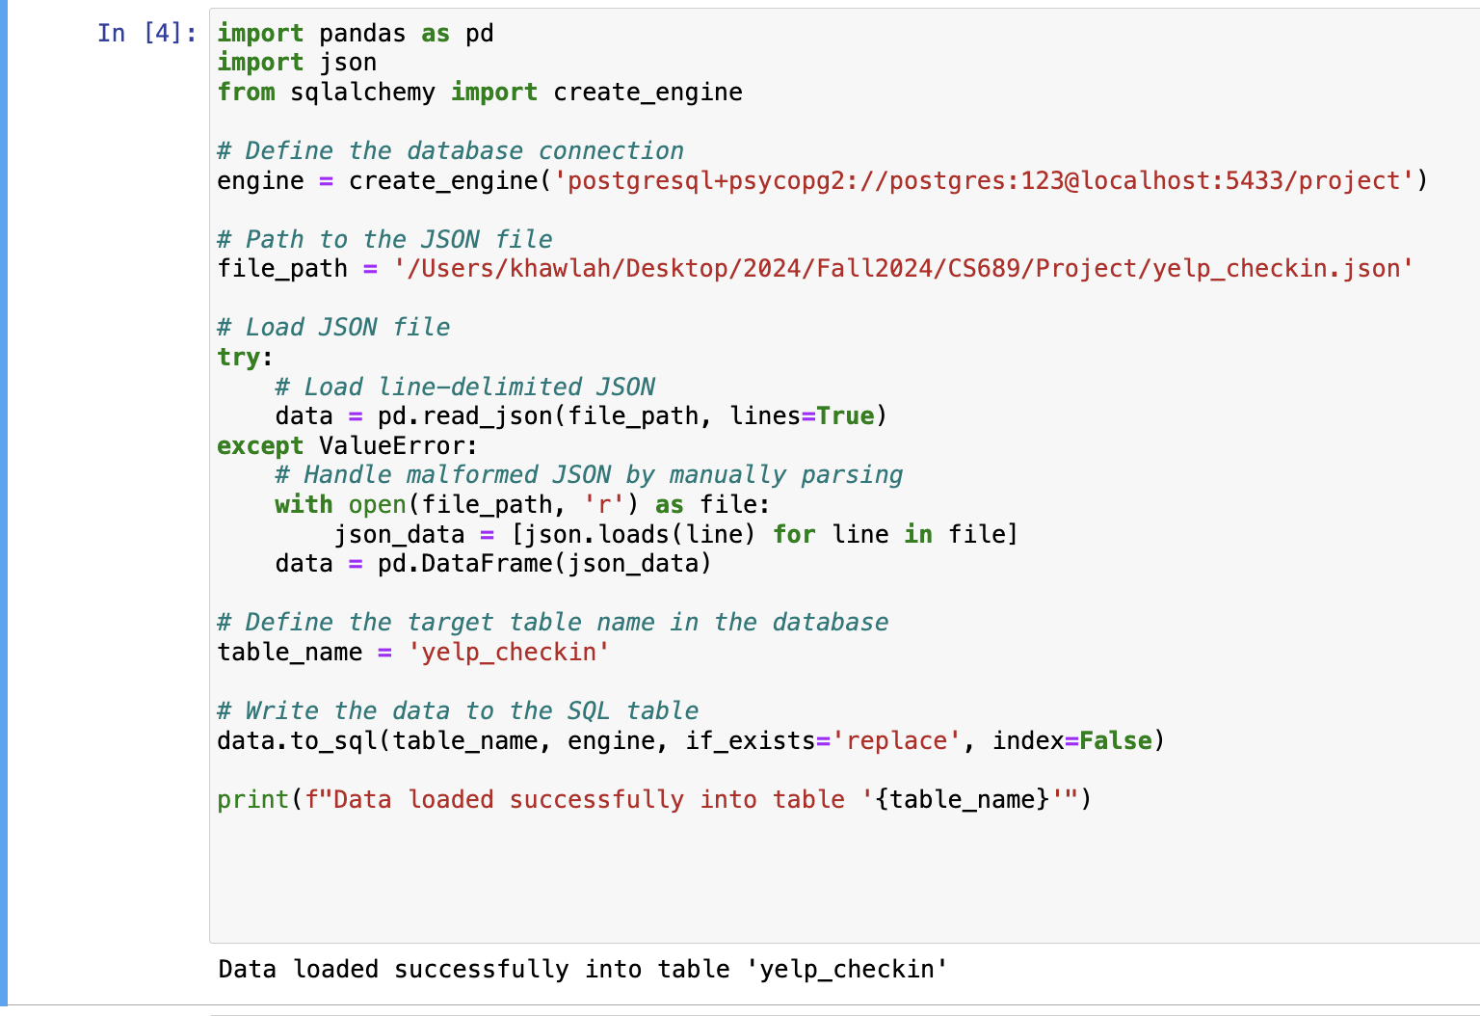
Transform & Load Data (Python Part)

Slide 8
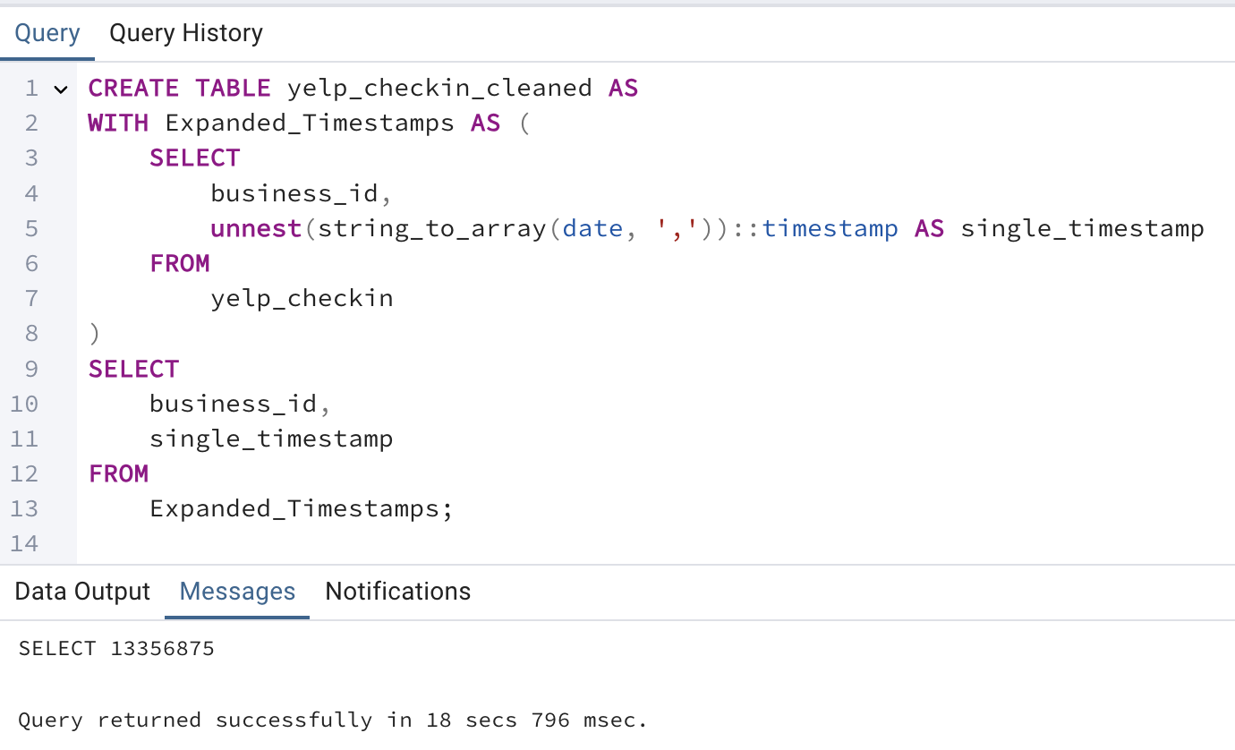
Transform & Load Data (DBMS Part)

Slide 9
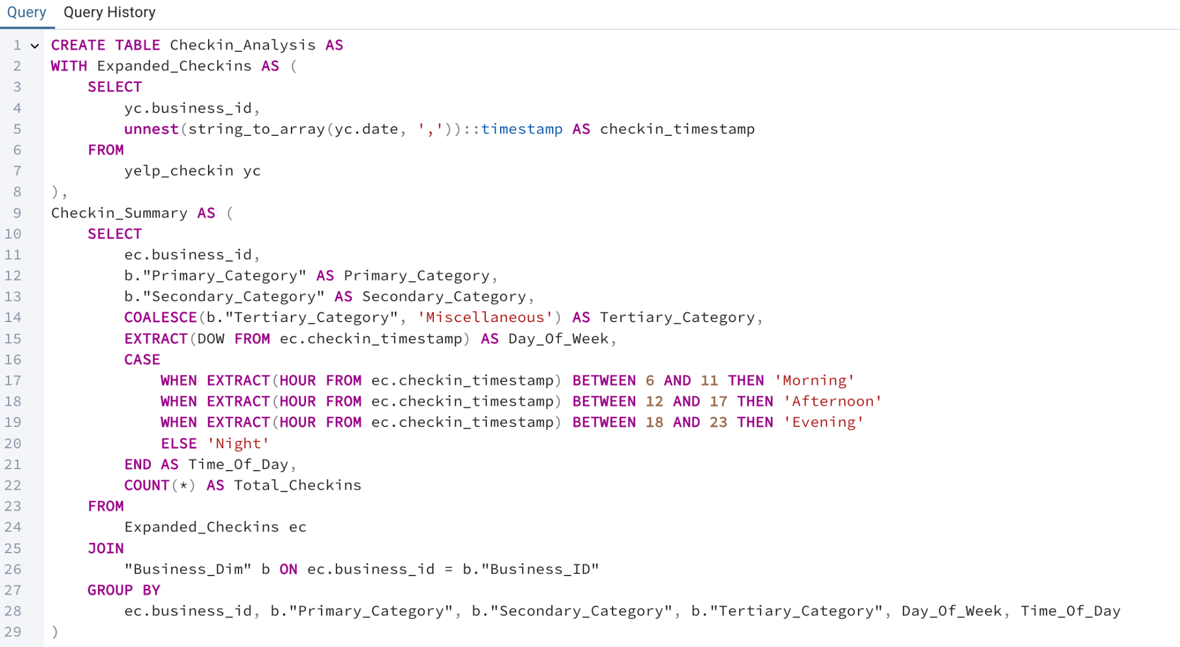
Transform & Load Data (DBMS Part)

Slide 10
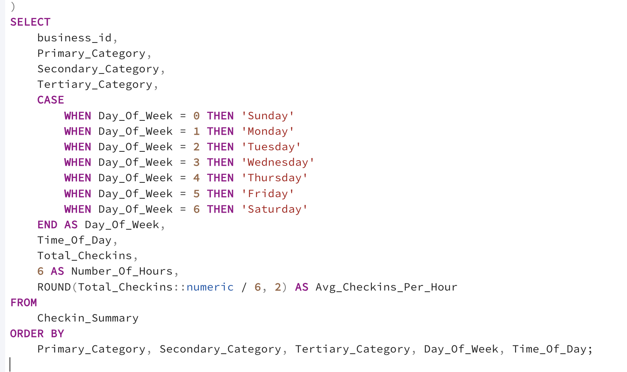
Transform & Load Data (DBMS Part)

Slide 11
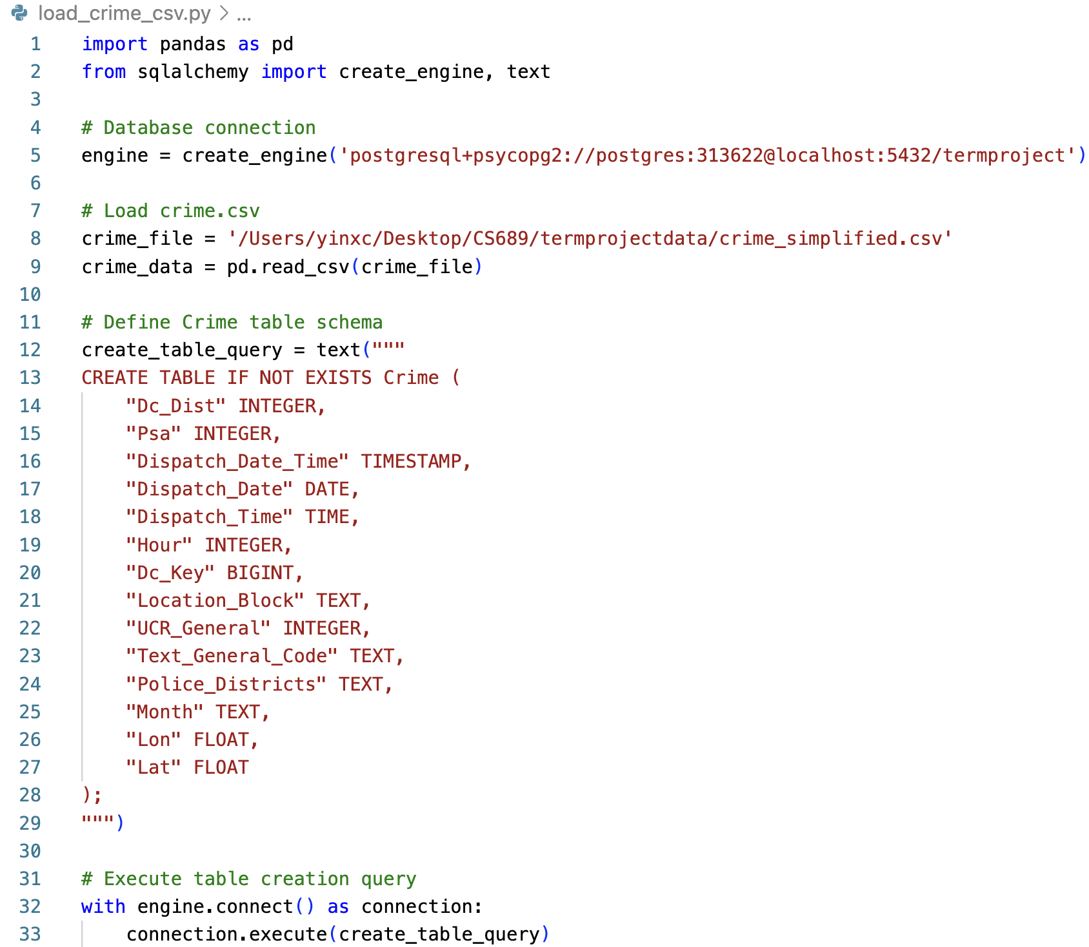
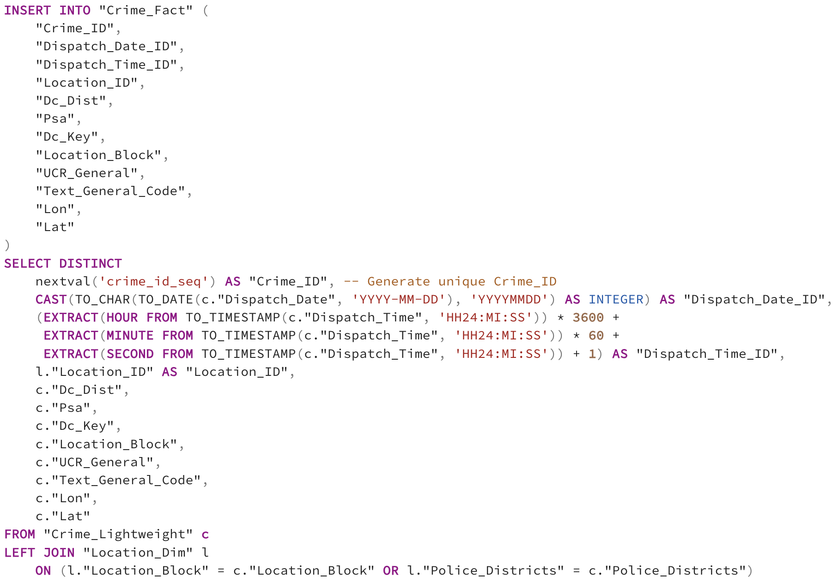
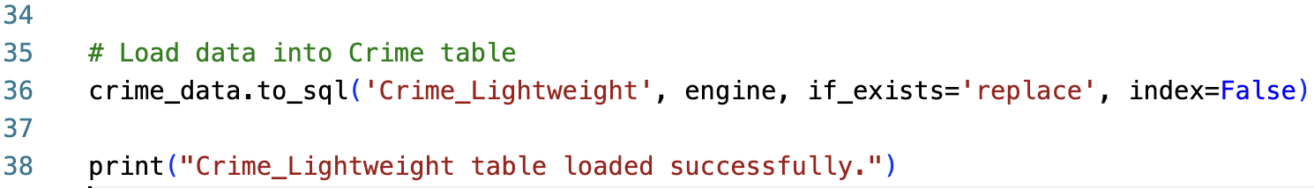
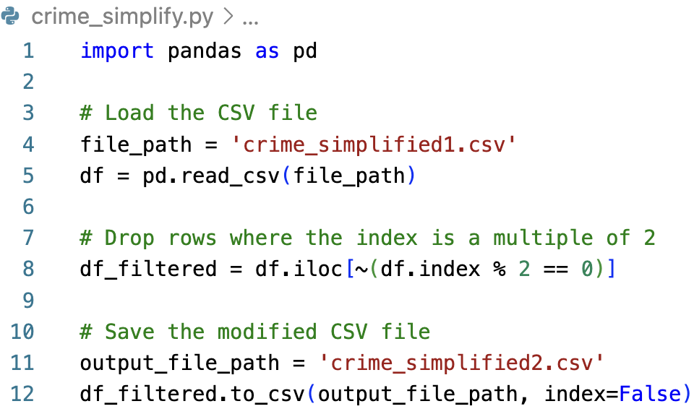
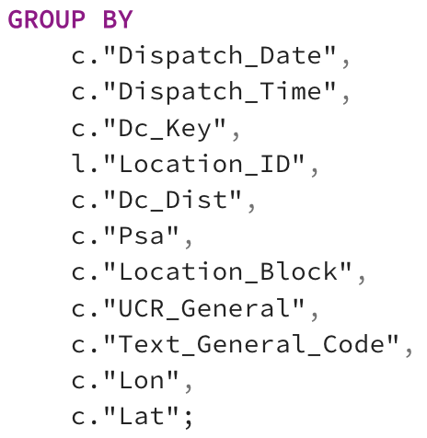
Load Crime_Fact
(There were too many data in crime.csv so we deleted some of them, with the lines that are multiple of 2 for several times to make a light weighted crime file)

Slide 12
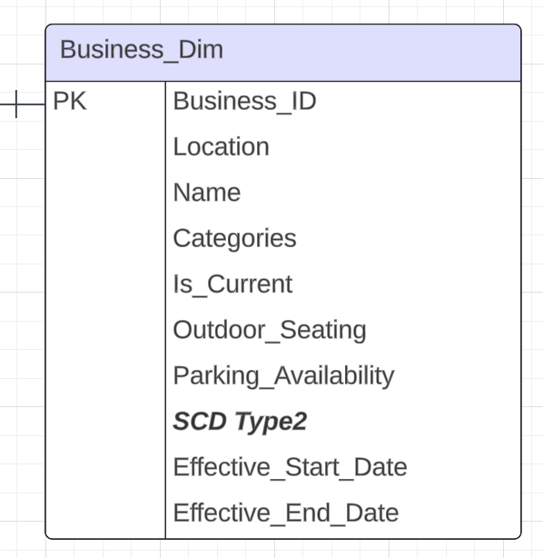
SCD2 (Business_Dim)
Tracks Business changes over time with Effective_Start_Date and Effective_End_Date;
Uses Is_Current to flag the active record;
Inserts new rows for updates instead of overwriting;
Keeps historical data for analysis;

Slide 13
Delta Data SCD2 (Business_Dim)
How to insert Delta Data:
If the ID is in current data, check if the content is the same with the same ID one; If not same, then insert the delta data and set current of the previous data to be 0;
If the ID is not in current data, means this data is a new data, append it into the data frame.

Slide 14
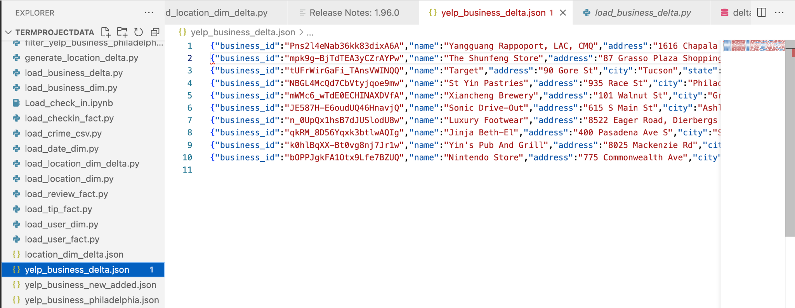
Prepare Delta Data

Slide 15
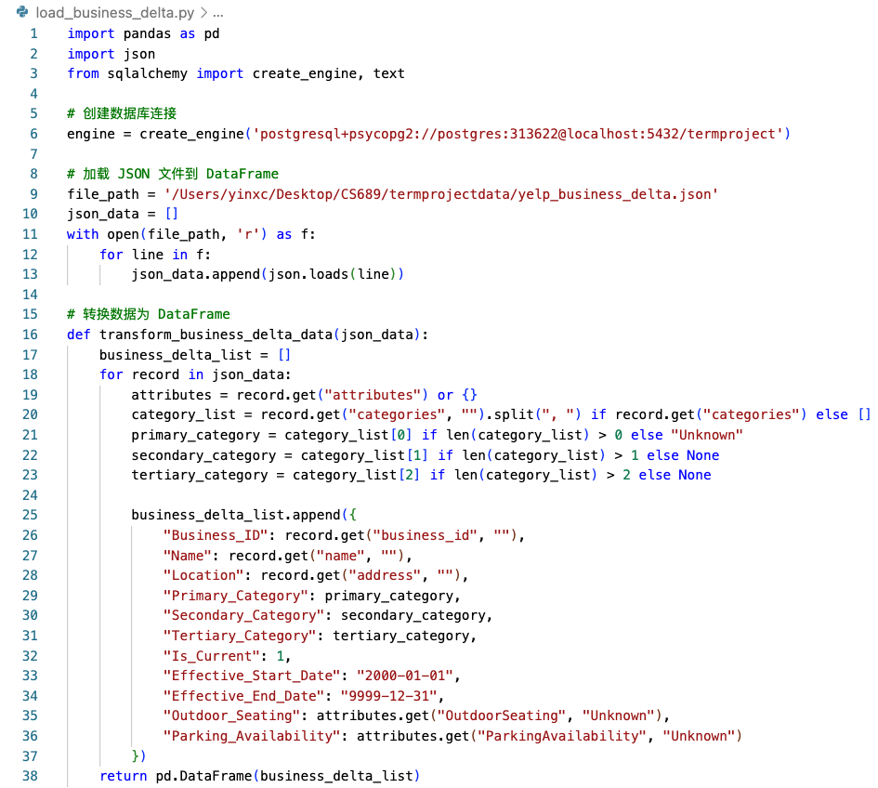
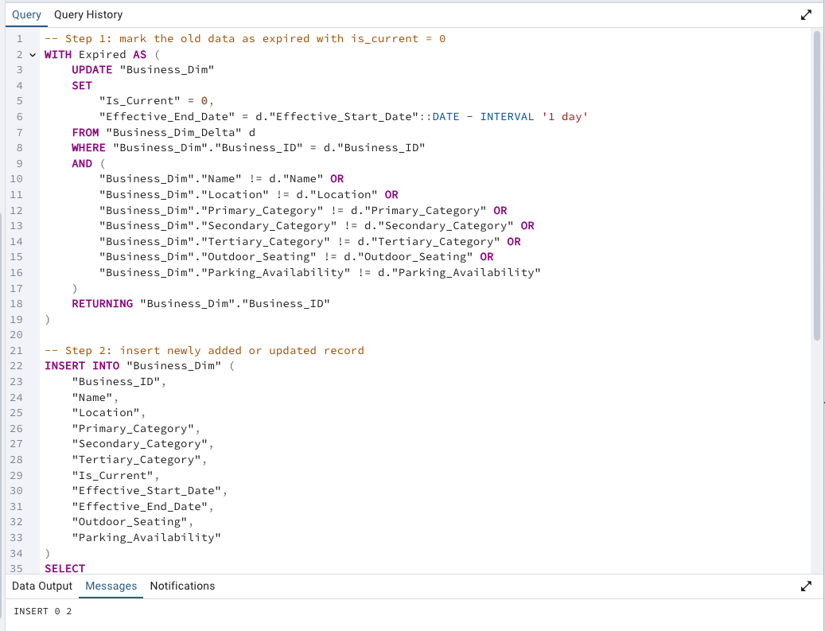
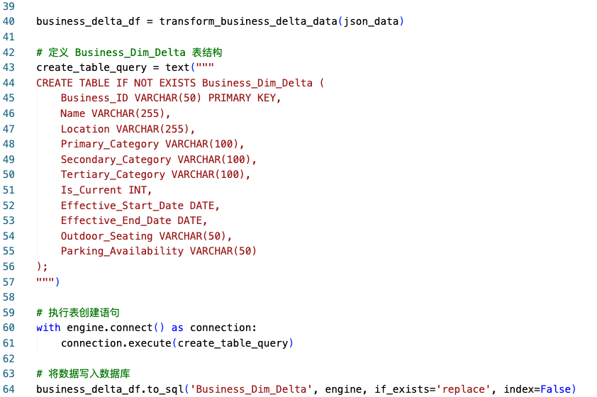
Load Delta Data SCD2 (Business_Dim)
2, Check if New Data or Updated Data or other, modify accordingly
1, Get and Load Delta Data to PostgreSQL

Slide 16
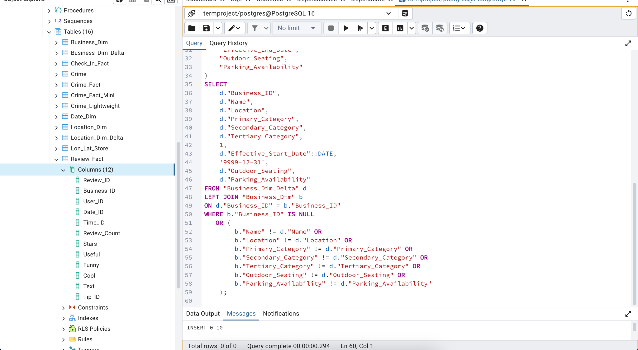
Check New Added Data
Data successfully loaded.

Slide 17
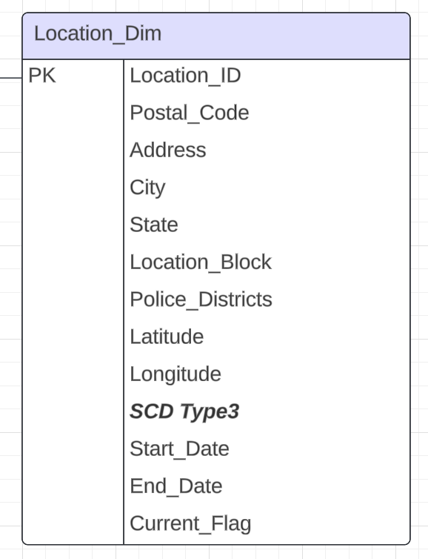
SCD3 (Location_Dim)
Tracks historical changes of location.
Use Current_Flag to identify active records.
Use Start_Date and End_Date for change tracking.

Slide 18
Delta Data SCD3 (Location_Dim)
To insert Delta Data, check if the ID is in current data:
If ID exists and attributes are different, update the previous values to a "previous" column and update the record with new current values. If the same, do nothing.
If ID does not exist, insert the new record

Slide 19
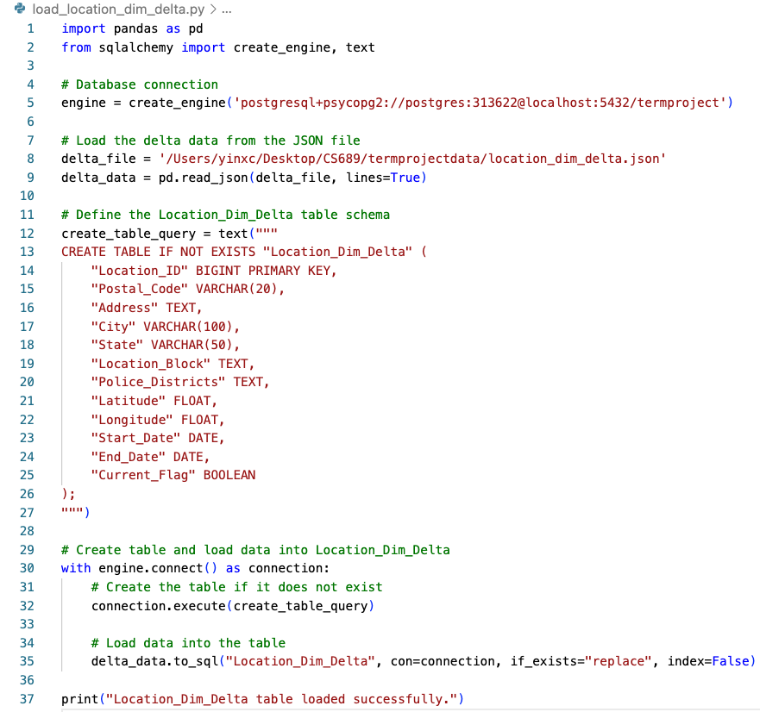
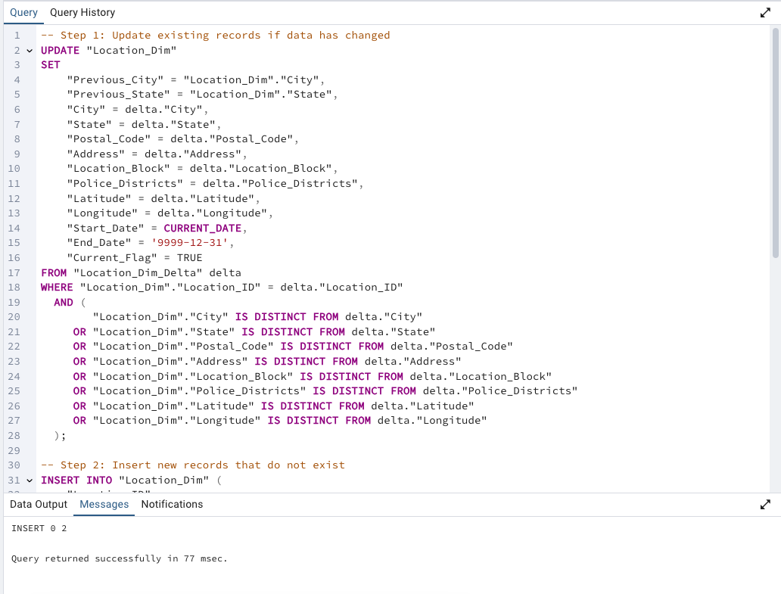
Load Delta Data SCD3 (Location_Dim)
1, Get and Load Delta Data to PostgreSQL
2, Check if New Data or Updated Data or other, modify accordingly

Slide 20
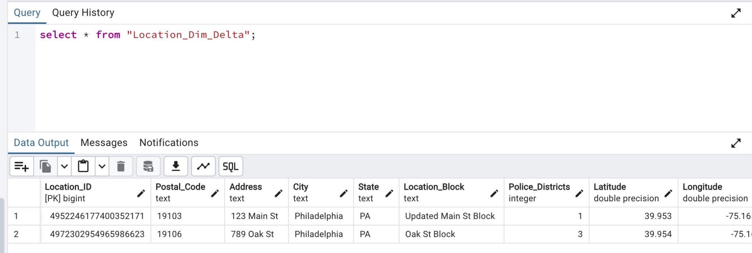
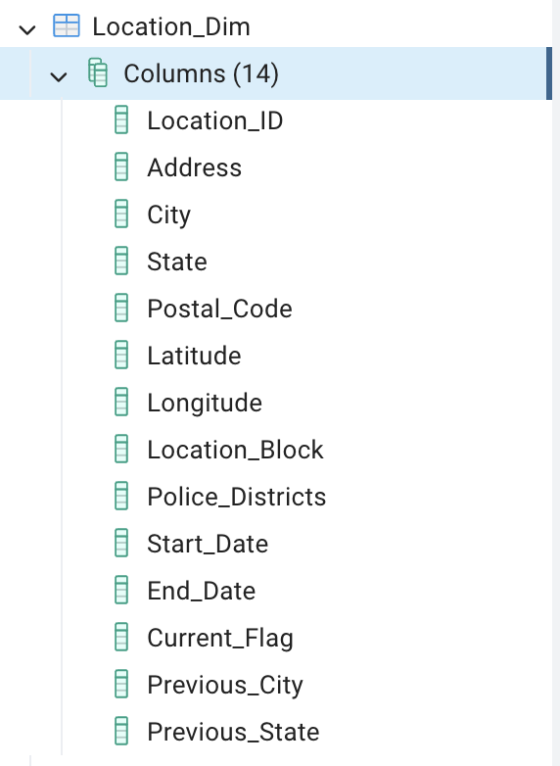
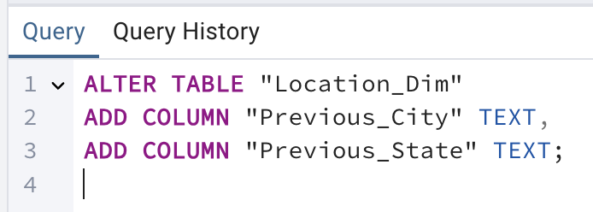
Load Delta data

Slide 21
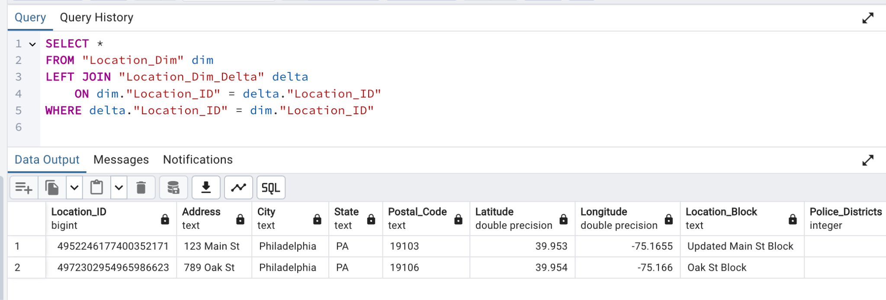
Check Inserted Delta Data
Delta Data have been loaded successfully.

Slide 22
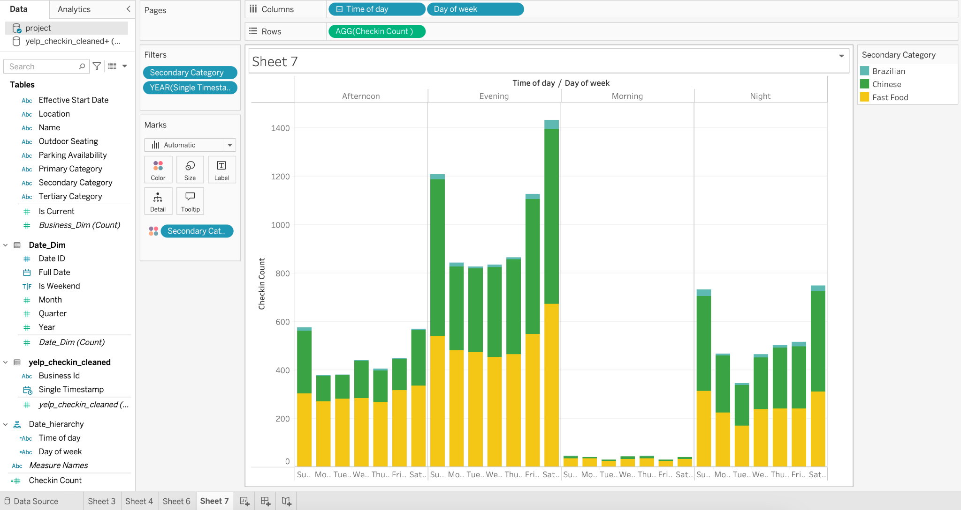
How does the time of day, day of week andcuisine type, impact customer check-ins ?

Slide 23
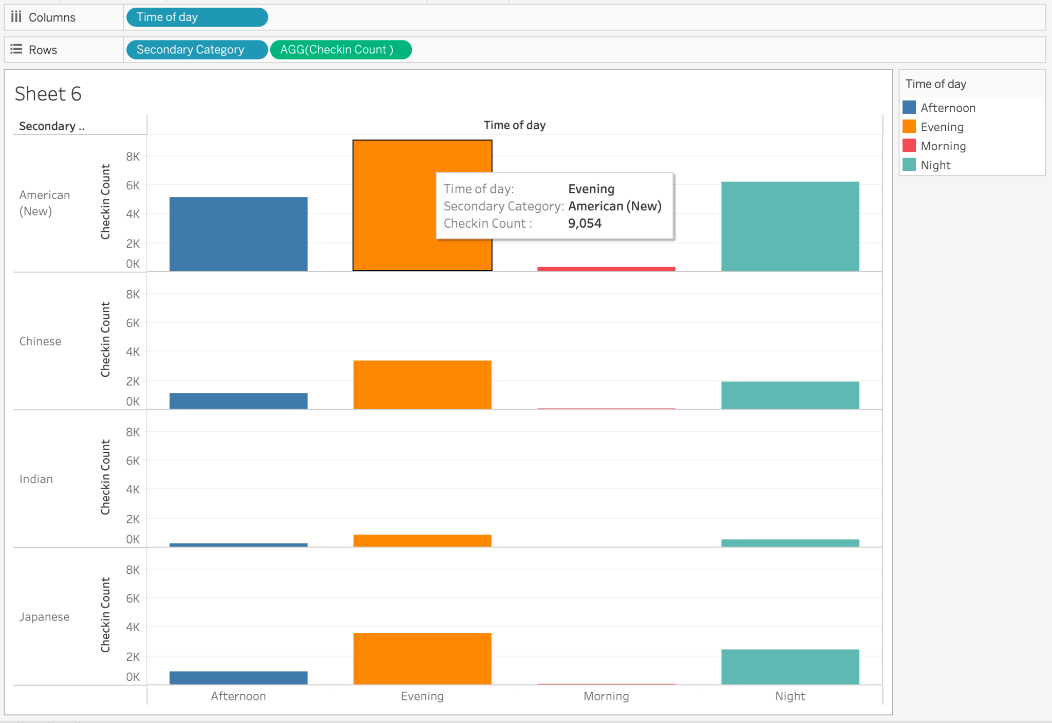
Which cuisine types have the highest check-ins during different times of the day?

Slide 24
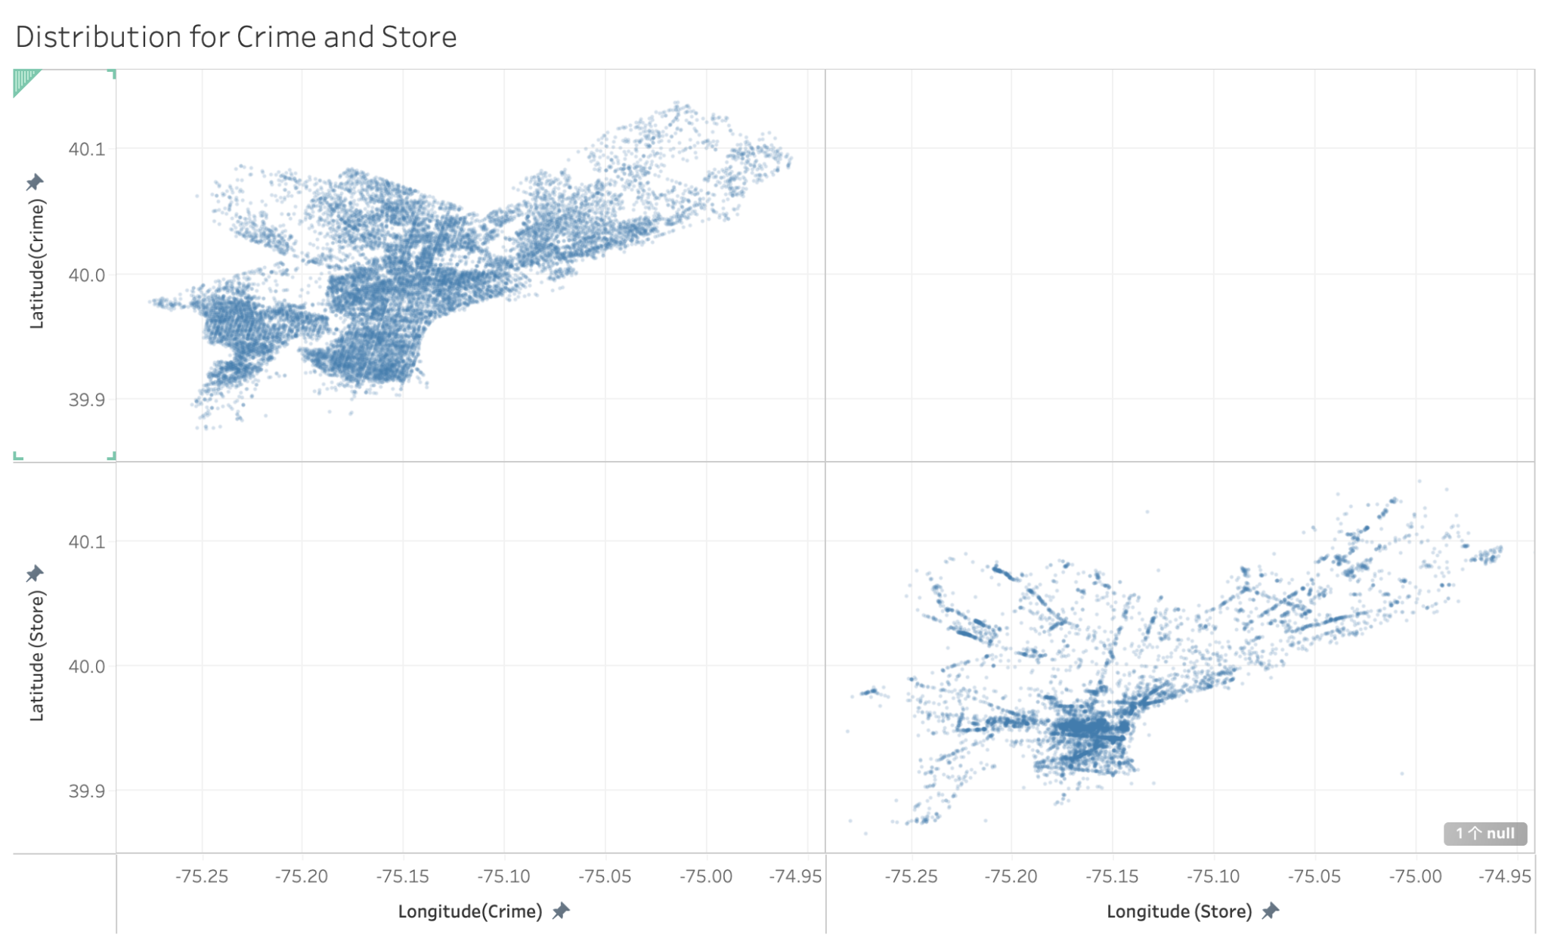
Distribution of Crime Events and Stores

Slide 25
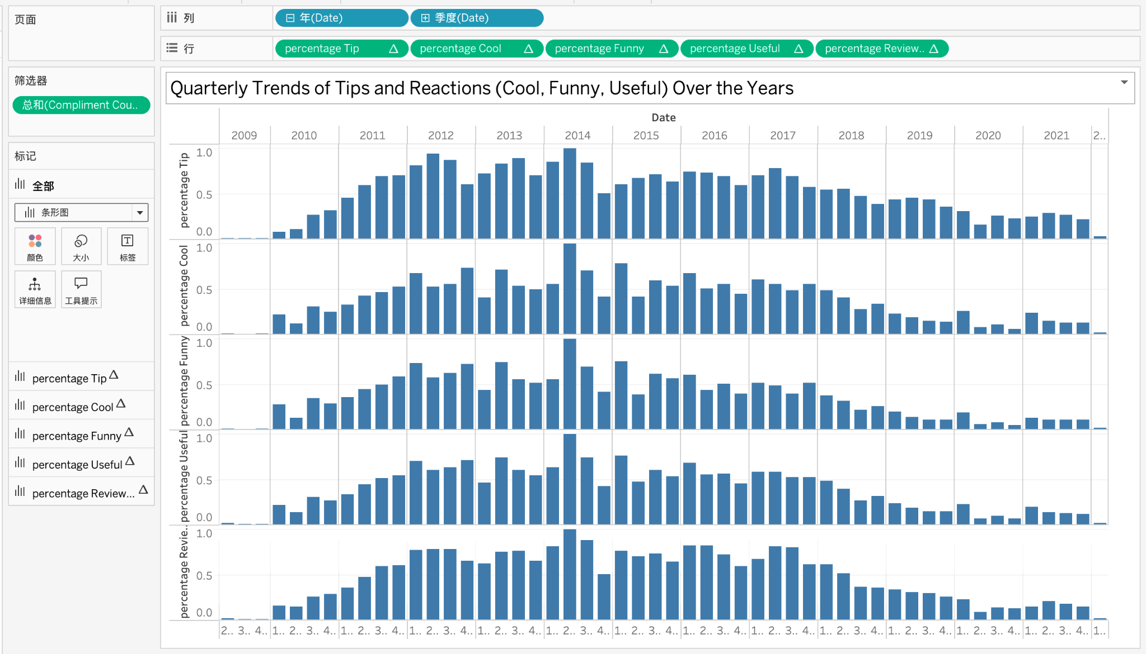
Quarterly Trends of Tips and Reactions (Cool, Funny, Useful) Over the Years

Slide 26
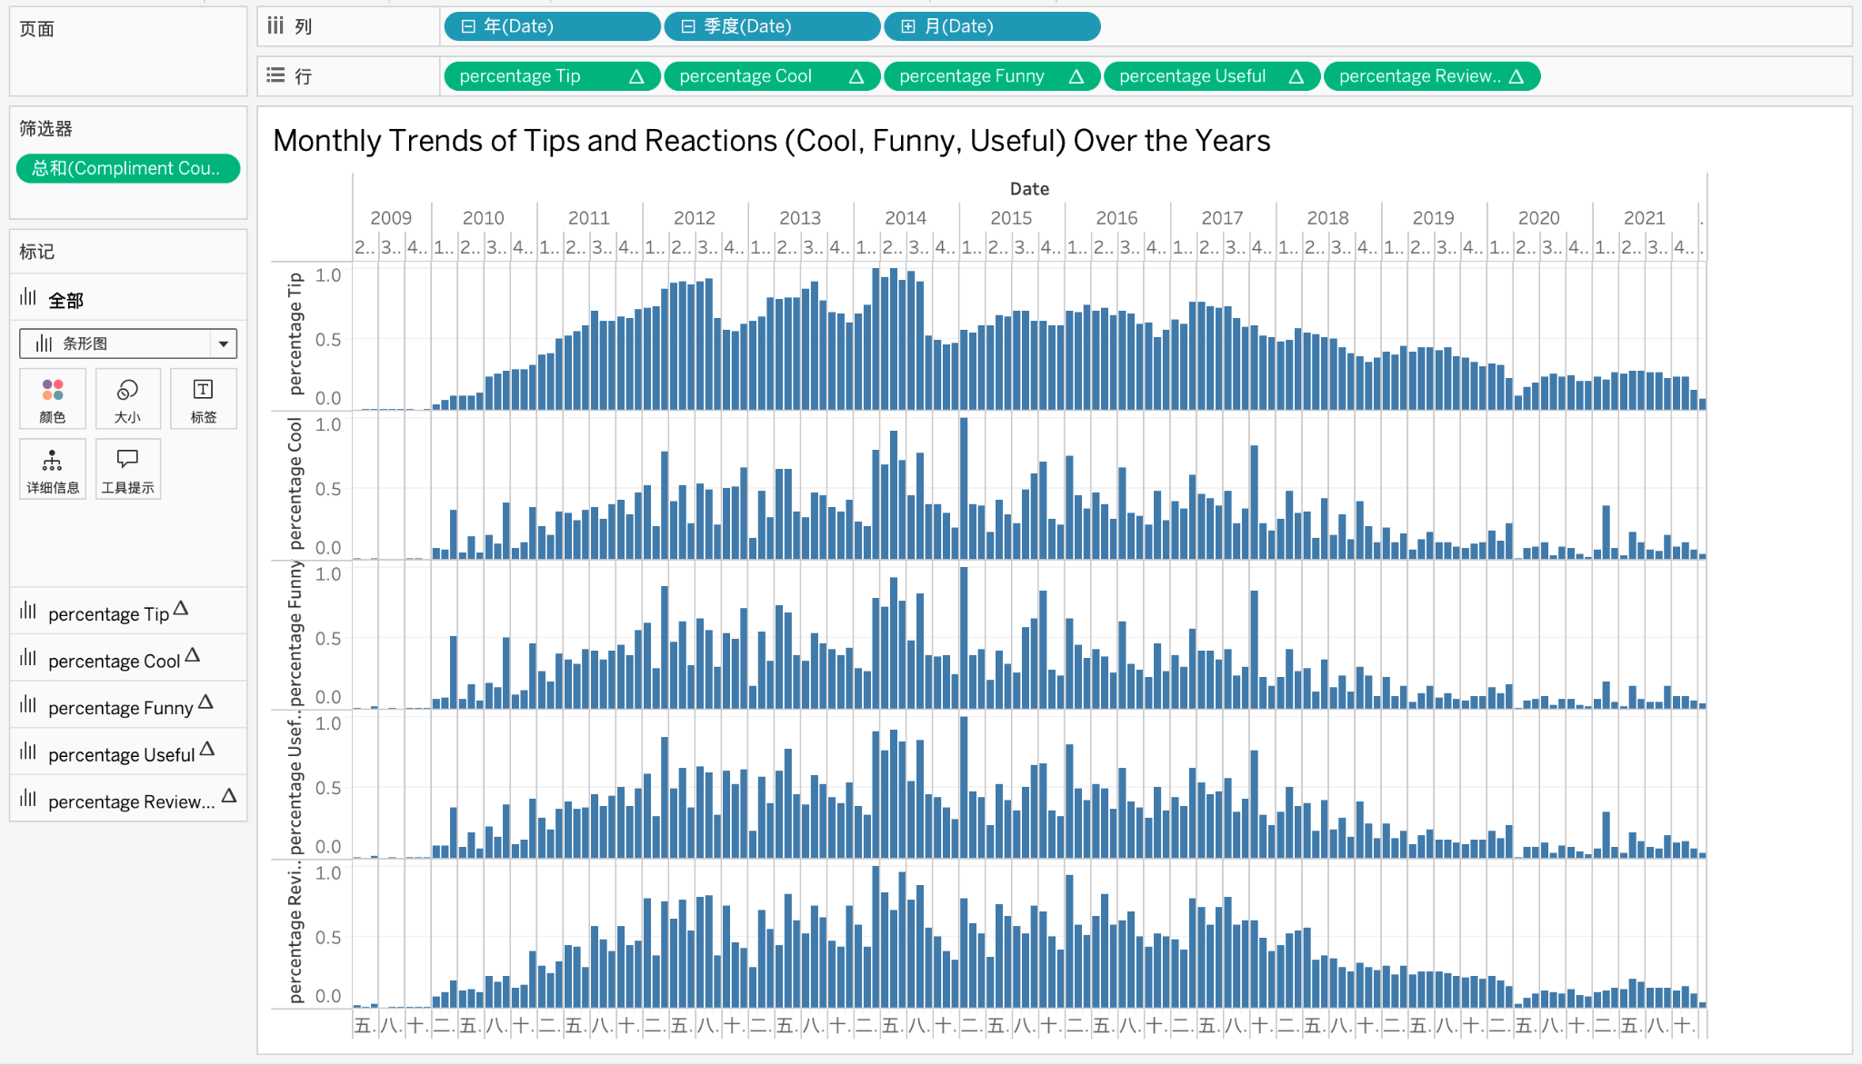
Monthly Trends of Tips and Reactions (Cool, Funny, Useful) Over the Years

